Slide 1
(GLC231) Summit Flex Theramedic Flex Analysis of common failures

Slide 2
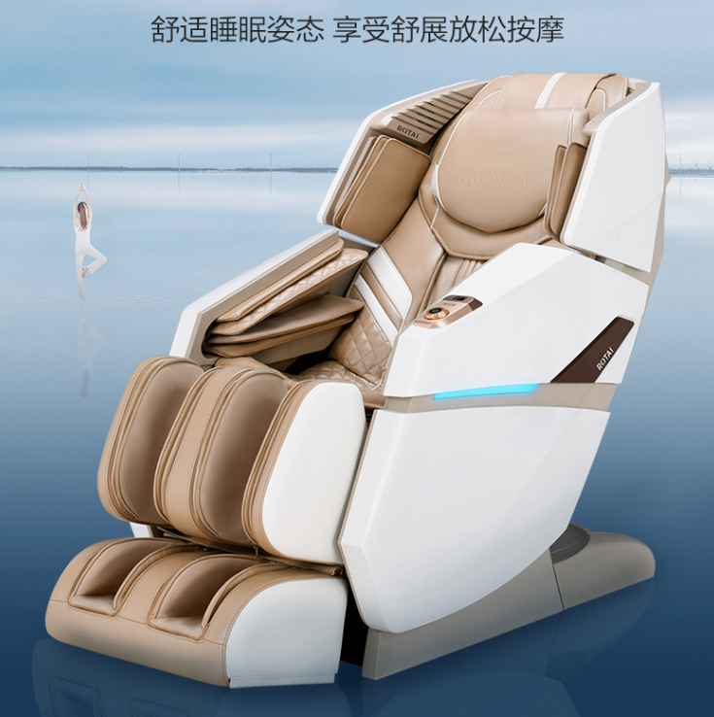
Massage chair

Slide 3
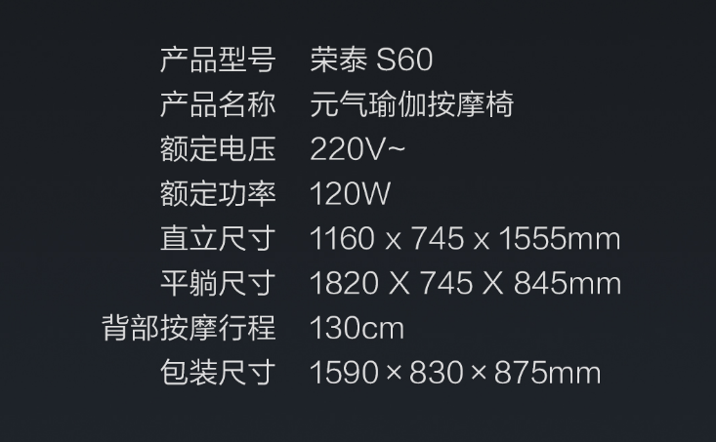
Massage chair parameters

Slide 4
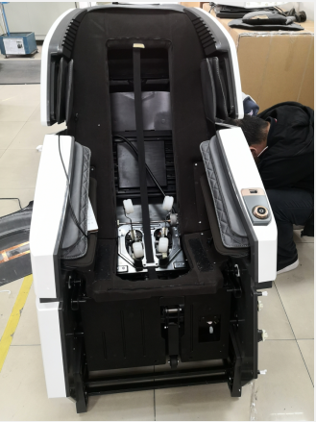
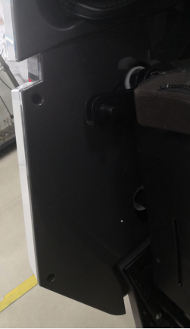
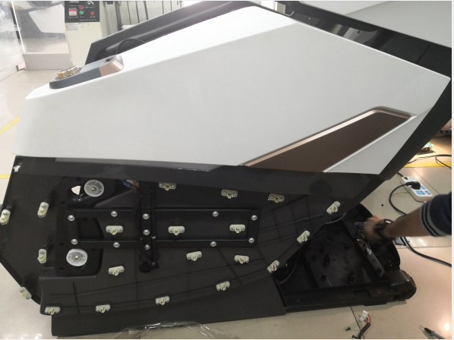
Armrest disassembly
1. Remove the 2 outer cover screws on the side of the armrest and pull out the outer cover of the armrest
2. Cut out the decorative strip

Slide 5
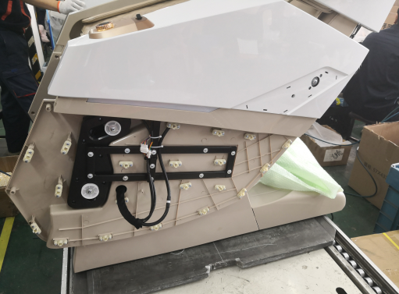
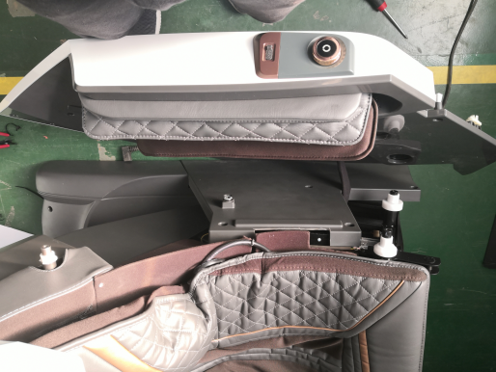
Handrail disassembly step instruction diagram
3. Remove the 3 fixing screws, unplug the plug-in unit and the trachea
4. Pull out to remove the armrest

Slide 6
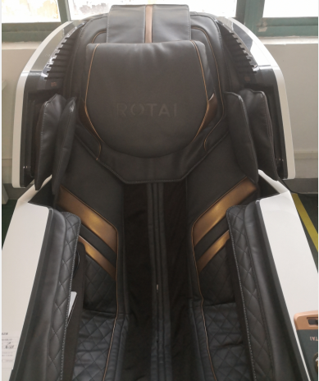
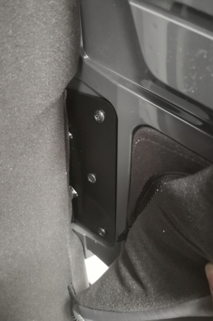
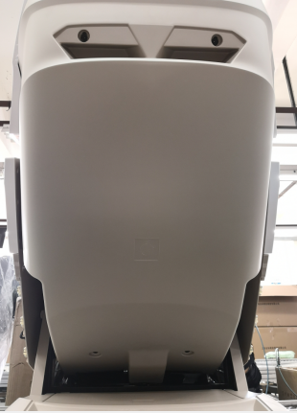
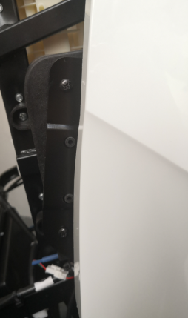
Instruction diagram of shoulder disassembly steps
2. Remove the 4 fixing screws of the rear cover
3. Remove the 3 fixing screws on the shoulder and take off the shoulder assembly.
1. Open the shoulder airbag holster and remove the 3 fixing screws

Slide 7
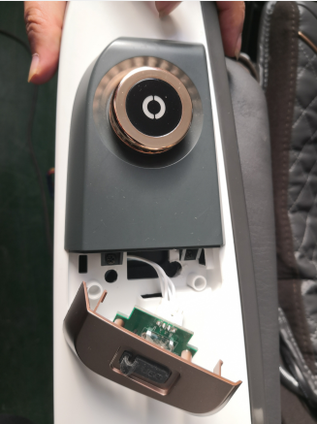
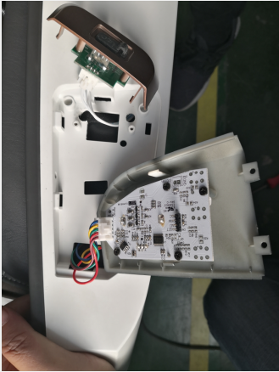
Steps for disassembly and assembly of the left armrest button switch
1. Pry open the USB charging cover and remove the 2 screws of the button cover
2. Remove the fixing screws to replace the button switch board

Slide 8
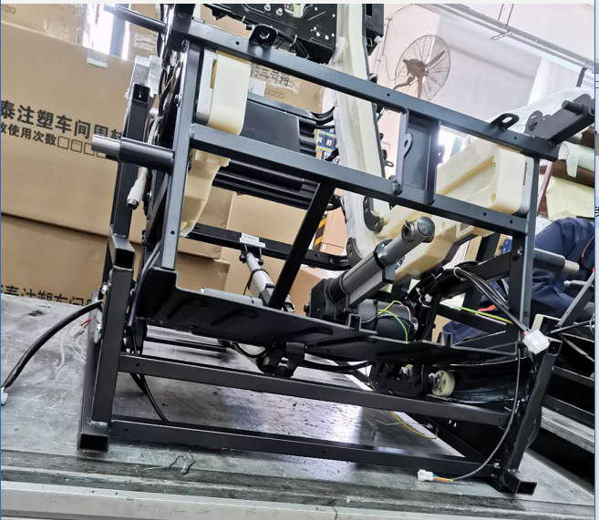
Electric cylinder plug-in instruction diagram
Backrest electric cylinder plug-in
white DC24V/76mm with Hall
Calf electric cylinder plug-in Red DC24V/106mm with Hall
Remove the upper and lower baffles, and then remove the fixing screws at the front and rear of the electric cylinder and pull out the corresponding plug-in to remove it.
Front sliding electric cylinder plug-inYellow DC24V/76mm with Hall

Slide 9
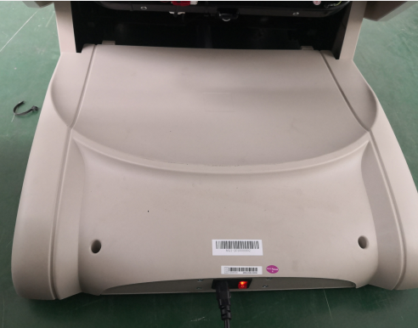
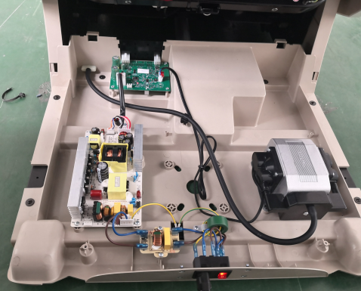
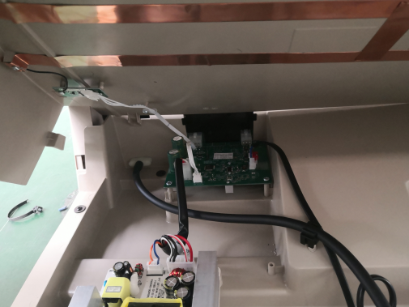
Power box disassembly instruction
Power box motherboard
air pump
Remove the 2 screws of the power box
Unplug the anti-pinch switch plug
Power board
Filter board
Power switch assembly

Slide 10
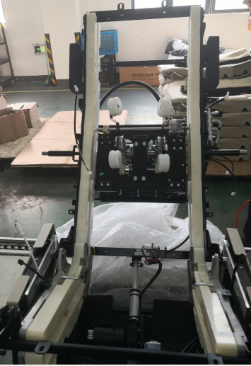
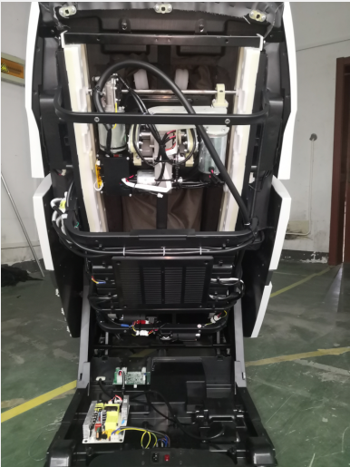
Mechanism disassembly
Walk motor
Knead motor
Mech PCB
Width detec PCB
Front
Knock motor
Back PCB
Power box motherboard
Power board

Slide 11
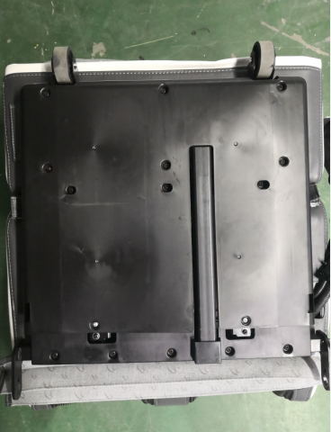
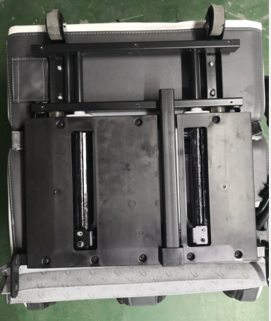
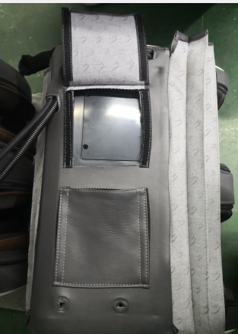
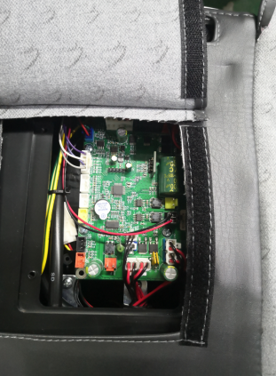
Legrest PCB disassembly
1.Remove the fixing screws of the upper and lower cover of the lower leg, and fix the upper leg of the telescopic frame with 4 screws
2.Remove the 2 screws to fix the calf cover
3.Legrest CPB

Slide 12
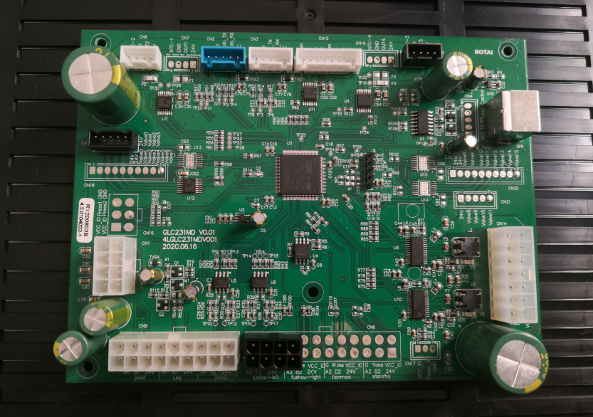
Back PCB
Bluetooth
APP
LED Light on arm
Back heating
Back heating
Remote
Air valve
Shoulder pinch prevention
DC24V/
DC5V
Leg&back cylinder
Mech communication
Leg communication
Arm keyboard
USB charging
Shoulder pinch prevention

Slide 13
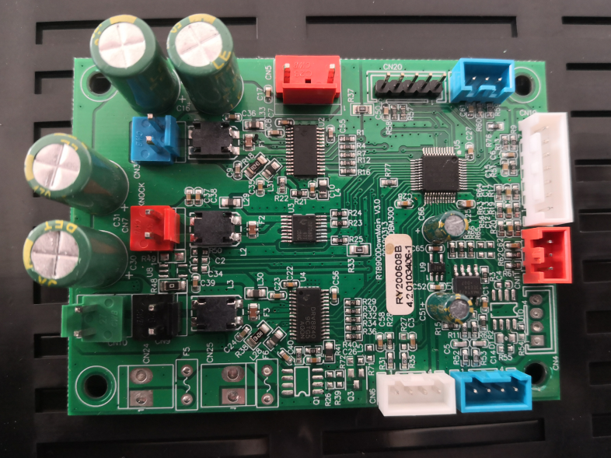
Mech PCB
Kneading motor counting signal plug-in
DC24V
Knead motor
width signal plug-in
Knock motor
Knocking motor count signal plug-in
Walking motor test plug-in
Mech communication signal plug-in
Walk motor
Traveling motor stroke signal plug-in

Slide 14
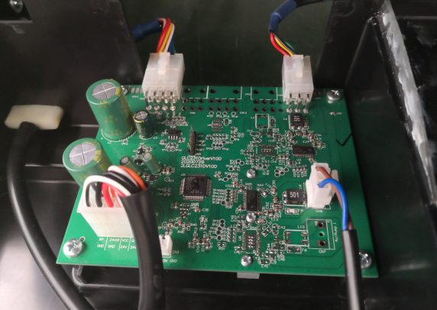
Power box motherboard
Backrest signal
Front sliding electric cylinder
Air pump plug-in
Power board input plug-in
Power box anti-pinch plug-in

Slide 15
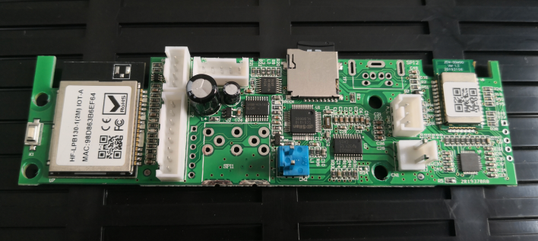
Bluetooh board/
User connecting board
Bluetooth signal plug-in
TF card
APP signal
Speaker
Speaker

Slide 16
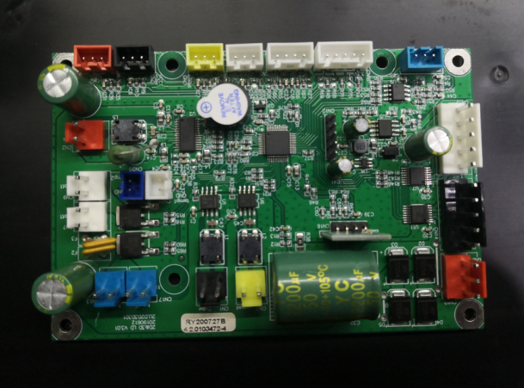
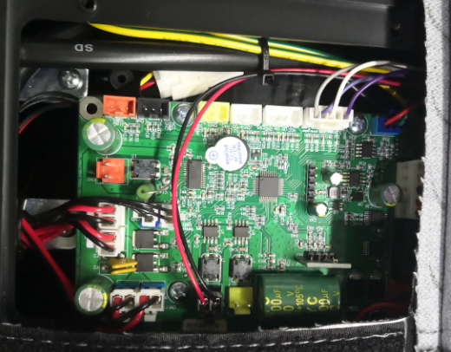
Legrest PCB
Calf roller signal
Calf communication signal
Air valve
Heating sensor
Air valve
Power
Heating
Heating
Roller motor

Slide 17
III. Product troubleshooting and maintenance
1. The hand controller can't turn on the chair
2. The kneading motor does not work
3. The knocking motor does not work
4. The walking motor does not work
5. Fuse short circult
6. The electric cylinder of the calf and backrest does not work
7. The front sliding electric cylinder does not work
8. The airbag does not work locally or in a certain part
9. The whole chair does not inflate
10. The USB interface cannot be charged
11. The calf roller does not work

Slide 18
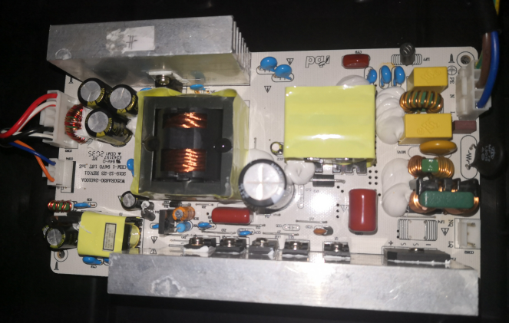
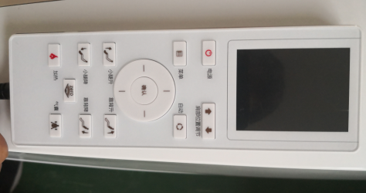
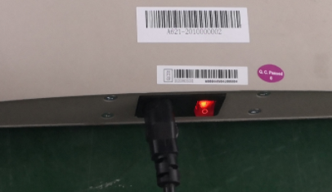
1.hand controller can't turn on the chair
AC110V
DC5V
Possible Reasons: |  | Troubleshooting method
1 | Remote or harness broken | 1 | Make sure the power Indicators Light is on, check if problem solved with another remote
2 | Power PCB broken | 2 | Check if there is DC5V output from the joint in Pic.2
3 | Main PCB broken | 3 | Check if light on main PCB is on, if no light on, then main PCB is broken
4 | Remote shield harness broken | 4 | If main PCB is well, check the Remote Shield Harness(The one from bluetooth PCB to remote) with a multimeter
 | PS: If there is no DC5V output from power PCB, then check if there is AC110V input on Pic.2: If AC110V exists, then power PCB is broken; If AC110V does not exist, then check if connection of Filter PCB& harness.

Slide 19
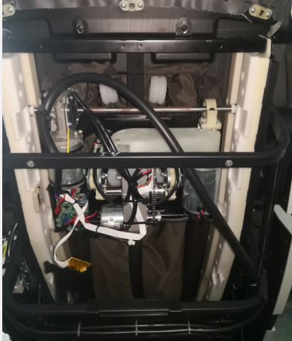
2 Kneading motor does not work
Kneading motor
Kneading motor plug-in
Knocking motor
Knock motor plug-in
Pic.1 Pic.2
Possible Reasons: |  | Troubleshooting method
1 | Kneading motor broken | 1 | Select Sync massage in manual mode, then swap the Kneading motor to Knocking motor on Mech PCB to see if kneading motor works: If kneading motor works, then the harness or motherboard is broken; If not working, then motor is broken, need to change the motor. As Pic.2.
2 | Motherboard Broken | 2 | Return the motors to its original joint, then swap the kneading motor to knocking motor on Motherboard to see if kneading works: If kneading works, then motherboard is broken, need to change the motherboard. It can be checked with a multimeter as Pic.1.

Slide 20
3 Knocking motor does not work
Kneading motor
Kneading motor plug-in
Knock motor
Knocking motor plug-in
Pic.1 Pic.2
Possible Reasons: |  | Troubleshooting method
1 | Knocking motor broken | 1 | Select Sync massage in manual mode, then swap the Knocking motor to Kneading motor on Mech PCB to see if knocking motor works: If knocking motor works, then the harness or motherboard is broken; If not working, then motor is broken, need to change the motor. As Pic.2.
2 | Motherboard Broken | 2 | Return the motors to its original joint, then swap the knocking motor to kneading motor on Motherboard to see if knocking works: If knocking works, then motherboard is broken, need to change the motherboard. It can be checked with a multimeter as Pic.1.

Slide 21
4. walking motor does not work
walk motor plug-in
Knock motor
Knock motor plug-in
Limit PCB
walk
motor
图一 图二
原因分析： 排除方法：
1. 行走电机坏 1.选择手动功能揉敲同步手法，再选择定点功能，按上下行程键，手控器有
2.连接线束断 无双声滴滴声，上有下无则下行程检测板坏（更换）或行程信号线束断或
3.行程检测板坏 接触不良。下有上无则上行程检测板坏（更换）或行程信号线束是断或是
4.机芯主板坏 接触不良。图二
2.手动定点上下都能有滴滴慢单声声，说明行程检测信号正常，然后将机芯上电 机插件
（黑色与敲击电机插件（红色）对接，观察电机是否行走，不行走，为电机坏更换电机图二
3.将机芯电机插件回位，将主板上行走电机插件插到敲击电行走电机有无工作有为主板坏，
更换主板，无为线束坏，可用万用表检查， 更换线束。

Slide 22
三、产品故障排查及维修
5、烧保险丝
电源箱主板
DC24V
开关电源板
滤波板AC220V输出
保险丝
原因分析： 排查方法：
1.保险丝坏 1.如果因为电压波动导致保险烧坏，更换同型号保险丝（5A）.如图
2.滤波板短路 2.如果换了保险丝还是烧那就把图中红色标记插件拔掉再通电，如果还烧保险就更换滤波
3.开关电源板短路 板如图，如果不烧保险丝关电插件复原，在拔掉图中黄色图标插件，再通电烧保险那就是
4.主板元器件短路 开关电源板短路，更换开关电源板。
5.某个负载短路 3.如果不烧再关电把插件复位，把图中绿色图标插件拔掉再通电，如果烧保险说明是电源箱
主板不良，更换主板。如果不烧保险那就是机芯主板上有短路，把主板负载的插件拔掉，再
一个个插上，插到哪个插件烧保险，就说明这个插件负载短路，更换这个插件的负 载即可。

Slide 23
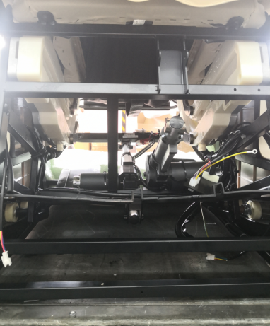
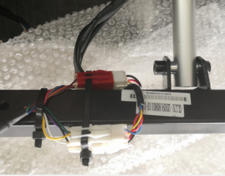
三、产品故障排查及维修
6、小腿、靠背电动缸不工作
小腿电动缸插件红色
靠背电动缸插件白色
小腿、靠背电动缸插件
靠背电动缸插
小腿电动缸插
原因分析： 排查方法：
1.电动缸坏 1.靠背、小腿两电动缸插件及工作原理是一样，可以借用工作正常电 动缸对换
2.主板坏 接口 ，对换后还是不能工作 ，为电动缸坏。
3.电动缸连接线断 2.对换后能工作，问题在主板或连接主板的连接线，可用万用表判断。

Slide 24
三、产品故障排查及维修
前滑电动缸插件白色
7、前滑电动缸不工作
前滑电动缸插
原因分析： 排查方法：
1.电动缸坏 1.前滑、小腿两电动缸插件及工作原理是一样，可以借用工作正常电 动缸对换
2.主板坏 接口 ，对换后还是不能工作 ，为电动缸坏。
3.电动缸连接线断 2.对换后能工作，问题在主板或连接主板的连接线，可用万用表判断。

Slide 25
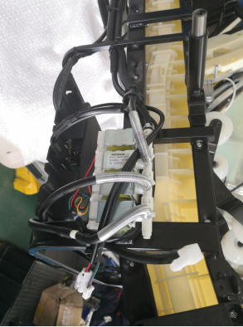
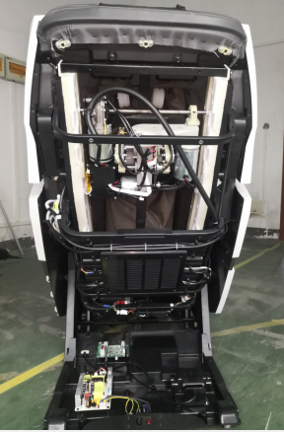
三、产品故障排查及维修
8.气囊局部或者某个部位不充气
肩臂气阀组件
气阀位置
肩臂气阀插件
图一 图二
原因分析： 排查方法：
1.气管折住脱落 1.检查不充气的部位的气管有没有折住
2.气阀坏 2.如果气管正常，那就要万用表通断档量气阀的好坏如图一以坐垫侧气囊气
3.主板坏 阀为例量黑色与红色，黑色与黄色数值在160-170说明气阀是好的就更换主板
，反之数值不在160-170相差太大说明气阀坏、更换气阀即可 。

Slide 26
三、产品故障排查及维修
9、整机气囊不充气
气泵插件
原因分析： 排查方法：
1.电源箱主板坏 1.手动打开全身气囊，看电控柜里面气泵是否工作，如果工作就万用表量如图
2.气泵坏 插件看是有AC24v输出 如果没有说明电源箱主板，更换电源箱主板。
2.如果气泵不工作，就用万用表量主板气泵插件看有无AC24v输出没有主板坏更
换主板，有的话说明气泵坏更换气泵

Slide 27
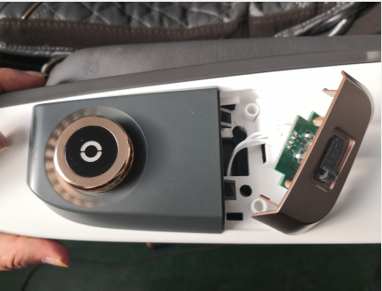
三、产品故障排查及维修
10、USB接口无法充电
滚轮电机插件
按钮件、USB充电插件
原因分析： 排查方法：
1.USB接口板坏 1、检查USB板ACC/GND触点有无DC5V电压，有电压检查接口
2.主板 是否不良或更换USB充电板。
3.连接线 2、无电压，检测主板插件有无DC5V电压，无为主板坏，更换主
机板。
3、主板有DC5V电压，用万用表检测主板到扶手充电板的连接线
的通断，或者对插件是否接触不良。

Slide 28
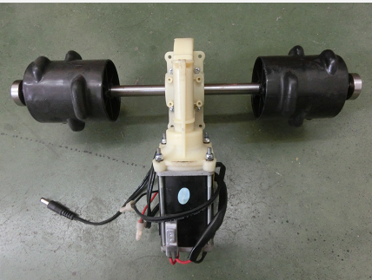
三、产品故障排查及维修
11、小腿滚轮不工作
滚轮电机插件
滚轮电机
图一
图二
原因分析： 排查方法：
1.主板坏 1、开启滚轮手法，万用表测量滚轮电机插件有无DC24V电压
2.滚轮电机坏 ，无电压检查为主板坏，更换主板。
3.滚轮电机到主板线束断或者接触不良 2、有电压，检测电机阻值，无穷大或无阻值为电机坏，更换电
机 。
3、电机阻值正常，万用表检测电机连接到主板的连接线的通断。

Slide 29
完毕
谢谢大家！！！

